Slide 1

PBR Visvodaya Institute of Technology & Science
Diabetes Prediction Using Machine Learning
Mini Project – B.Tech 2nd Year
From
Department of AIML
Submitted by
J. KAVYA SREE ( 2473A39100)
B.MADHURI (2473A39119)

Slide 2
Introduction
Understanding Diabetes and Early Detection
Diabetes is a chronic disease that affects the body's ability to regulate blood sugar levels.
Early detection of diabetes helps in preventing serious health complications. This project uses machine learning techniques to predict whether a person is diabetic based on medical parameters.

Slide 3

Problem Statement
Current Challenge
Traditional methods of diabetes diagnosis can be time-consuming and may require expert analysis.
The Solution
There is a need for an automated system that can predict diabetes accurately using patient health data.

Slide 4
Objectives
01
02
Analyze Dataset
Preprocess Data
To analyze a diabetes dataset
To preprocess medical data
03
04
Train Model
Predict Outcomes
To train a machine learning model
To predict diabetes status for new patients

Slide 5
Dataset Description
300
8
Records
Features
Number of Records
Number of Features
Dataset Details
Dataset Name: Diabetes Dataset
Target Variable: Outcome
0 → Non-Diabetic
1 → Diabetic

Slide 6

Data Preprocessing
Missing Values Check
Checked for missing values
Zero Value Treatment
Zero values in medical attributes treated as missing
Data Imputation
Replaced missing values with column mean
Clean Dataset
Prepared clean data for model training

Slide 7

Exploratory Data Analysis (EDA)
Patient Distribution
Feature Correlation
Analyzed distribution of diabetic and non-diabetic patients
Studied correlation between medical features
Data Visualization
Visualized data using graphs and heatmaps

Slide 8

Feature Selection
Input Features:
Target Feature:
Pregnancies
Outcome
Glucose
Blood Pressure
Skin Thickness
Insulin
BMI
Diabetes Pedigree Function
Age

Slide 9




Model Training
Algorithm Selection
Data Split
Algorithm Used: Logistic Regression
Dataset split into training and testing sets
Training Phase
Model Saving
Model trained using training data
Trained model saved using Pickle

Slide 10
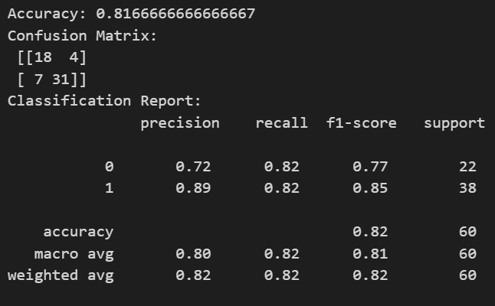




Model Evaluation
Evaluation Metrics Used:
Accuracy
Confusion Matrix
Precision
Recall
The model achieved good accuracy for diabetes prediction.

Slide 11
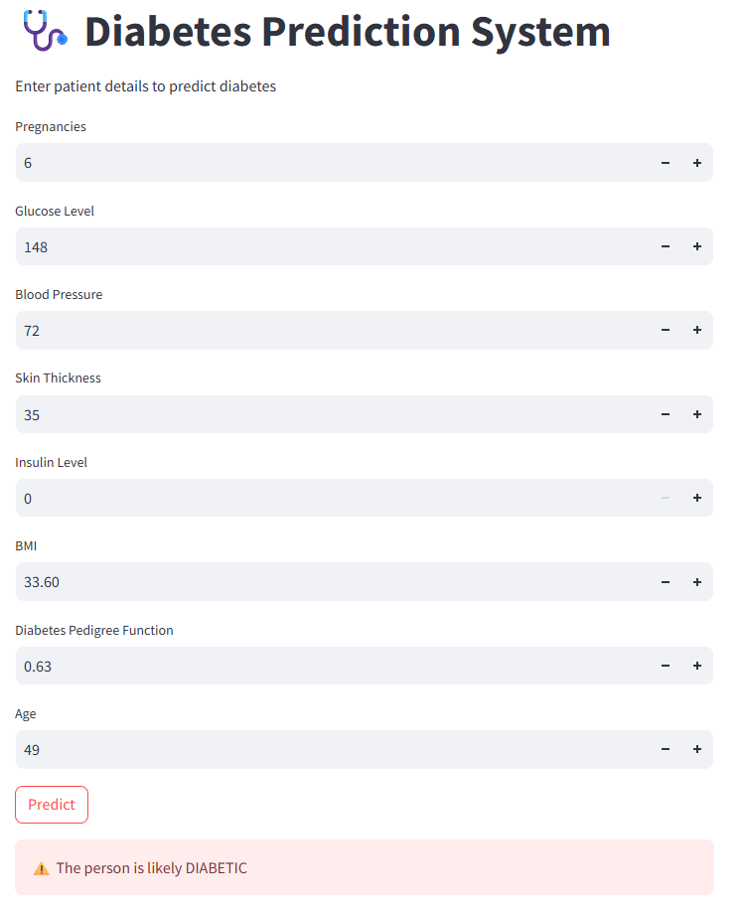
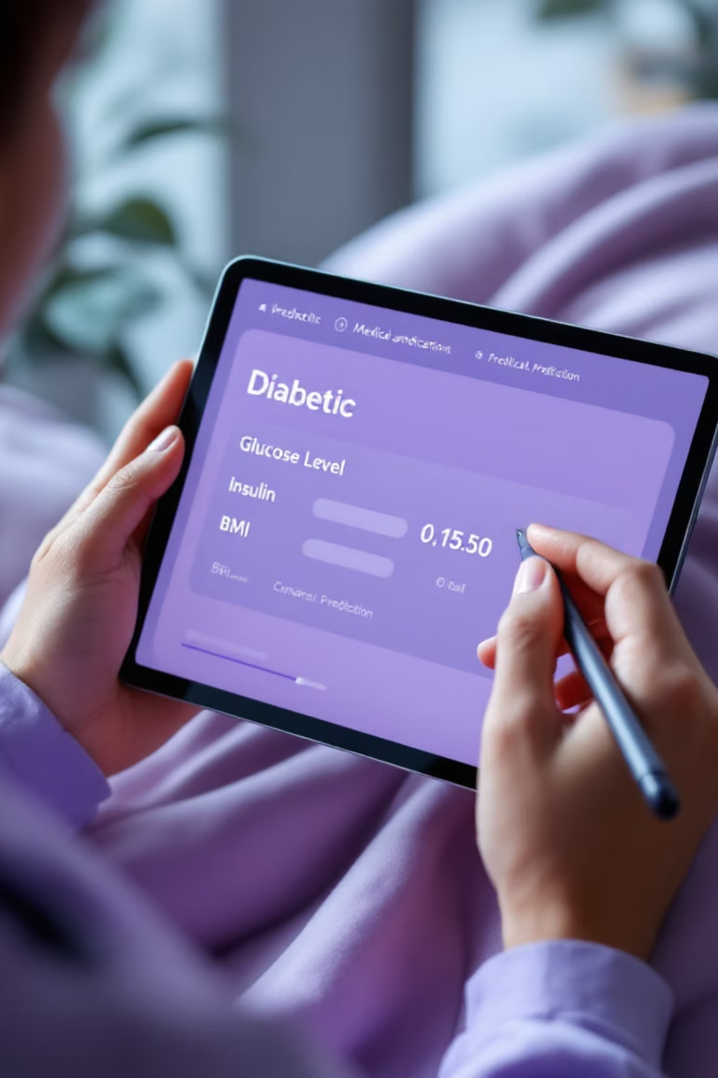
Prediction Output
01
User Input
Users enter their medical values into the system's interface.
02
System Processing
The input data is processed by the trained machine learning model.
03
Prediction Display
The system clearly outputs the prediction as either Diabetic or Non-Diabetic.
04
User-Friendly Interface
This streamlined process makes the system highly interactive and easy to understand for medical professionals.

Slide 12



Conclusion
Successful Prediction
Reliable Results
Enhanced Decision-Making
The machine learning system consistently and accurately predicts diabetes outcomes.
Logistic Regression proved highly effective, providing reliable and precise diagnostic results.
This system aids in early diagnosis, empowering medical professionals with critical data for timely interventions.

Slide 13





Future Scope
Building on our current success, here are the envisioned next steps for this project:
Advanced Algorithms
Explore more sophisticated machine learning models like Random Forests, Support Vector Machines, or Neural Networks for improved accuracy and robustness.
Larger Dataset Integration
Integrate larger and more diverse patient datasets to enhance the model's generalizability and predictive power across varied demographics.
Web Application Deployment
Develop a user-friendly web interface to allow medical professionals easy access to the prediction system for practical application.
Real-Time Prediction
Implement continuous data processing capabilities for immediate diagnostic insights, enabling quicker medical decisions and interventions.

Slide 14

Thank You

